Slide 1
Analysis of Public Sentiment: Reddit Discourse on the Israel-Palestine Conflict
Authors:
María Tapia Costa Mohamed Arafaath Sathik Basha
2nd May 2024

Slide 2
Table of contents
Motivation & Goals
Project outline
Dataset & preprocessing
Models for Sentiment Analysis
Evaluation
Topic Modelling with LDA
RoBERTa’s Sentiment distribution over time
Future Work

Slide 3



Motivation & Goals
Overall sentiment analysis regarding Israel-Palestine conflict.
World of marketing, politics or trading can benefit.
(Slightly) Contribute to advances in the field of language processing.
Research on the topic to have own substantiated opinion on the conflict.
Identify models which have greater fit in sentiment analysis.

Slide 4

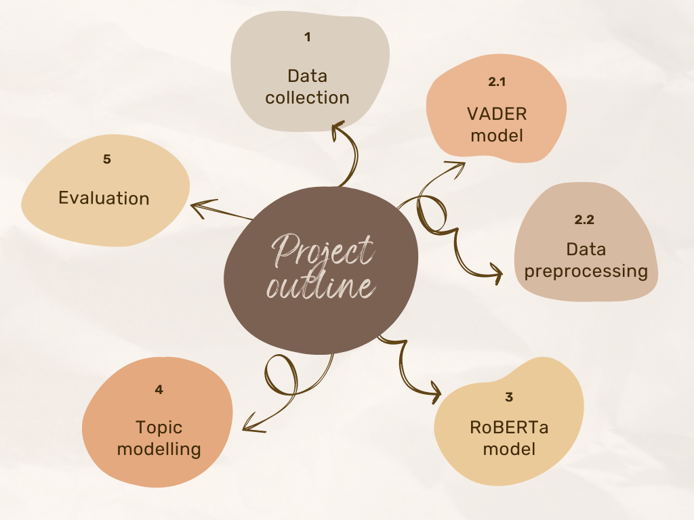

Slide 5
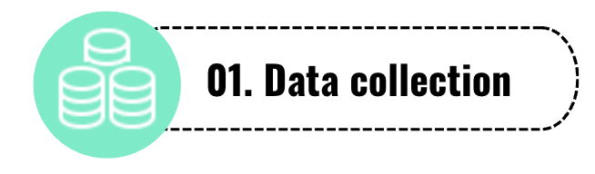

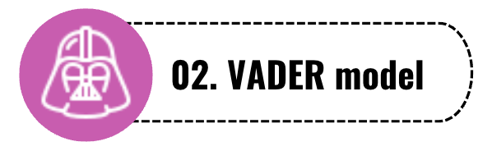
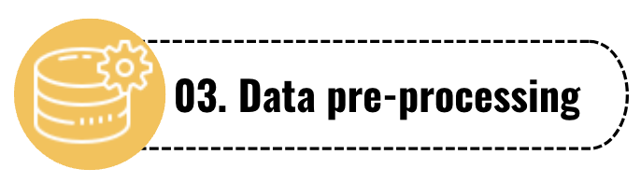
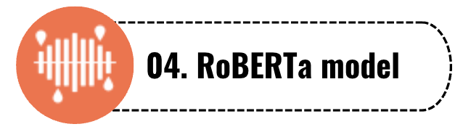
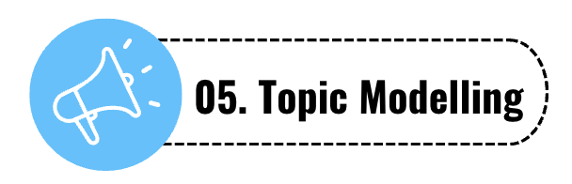
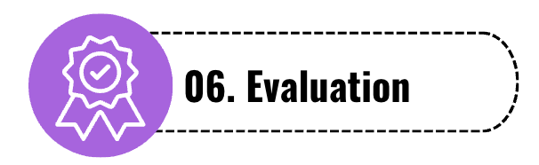

Slide 6



Data preprocessing I
→ Kaggle dataset¹ with over 1M entries
→ No labelling, manually was not an option
→ Data handling → Data cleaning
→ Data processing
→ Research papers, articles
→ VADER as baseline model
¹https://www.kaggle.com/datasets/asaniczka/reddit-on-israel-palestine-daily-updated

Slide 7

Data preprocessing II
→ 24 columns to only 7 including time posts and comments were created, post and comment content.
→ Importing dataset, crashed without NVIDIA GPU
→ Research on state-of-the-art techniques
→ Mixed types in multiple columns

Slide 8

Models for Sentiment Analysis
Vader:
It uses a pre-built sentiment lexicon (dictionary) containing words and their associated sentiment scores(pos, neg).
Evaluates each word considering context and gives a compound score -> create sentiment labels
These sentiments represent our new blind ground truth.
LSTM:
LSTM was build on Glove embedded (Twitter Glove-27k tokens, 100 vector dimensions)
input text with vader sentiments as labels
Improved RNN version mostly used for time series and sequences as well as Text analysis

Slide 9
Models for Sentiment Analysis
Twitter-RoBERTa-base:
It is a BERT based Transformer LM uses self-attention to prioritize embedding social media text.
BERT: 30k tokens, 16GB dataset.
RoBERTa: 50k tokens, 160GB dataset - Outperforms Bert as its trained on a larger dataset.
After extensive pre-processing, the data was input into the RoBERTa model to obtain sentiment labels.
Logistic Regression:
Default logistic regression for multi-class classification uses "One-vs-Rest" (OvR) mechanism.
It trains separate classifiers for each class versus the rest of the classes.
Final prediction relies on the highest predicted probability among all classes,
implicitly incorporating thresholding.

Slide 10

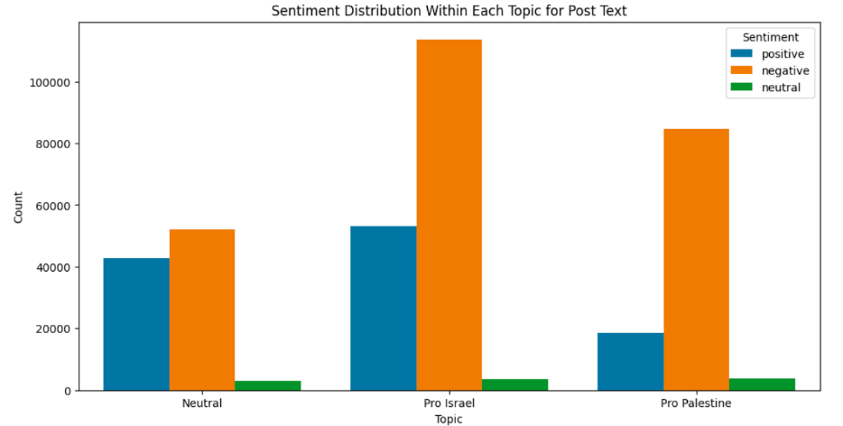
Evaluation
Limited preprocessing for Vader and LSTM resulted in poor performance.
Extensive preprocessing for Roberta led to highly accurate sentiment labels.
Logistic Regression on Roberta's sentiments achieved outstanding prediction accuracy.
Performance comparison:
- Vader + LSTM: 96%
- Roberta + Logistic Regression: 99%
~0.99
~0.96
RoBERTa
VADER

Slide 11
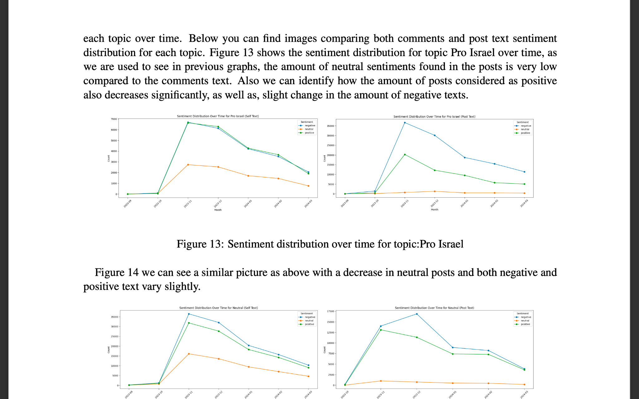
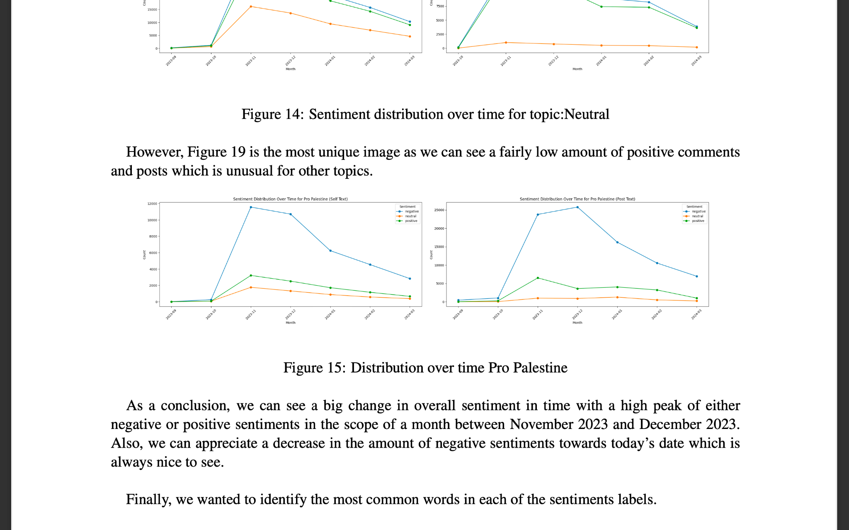
Topic Modelling with LDA

Slide 12
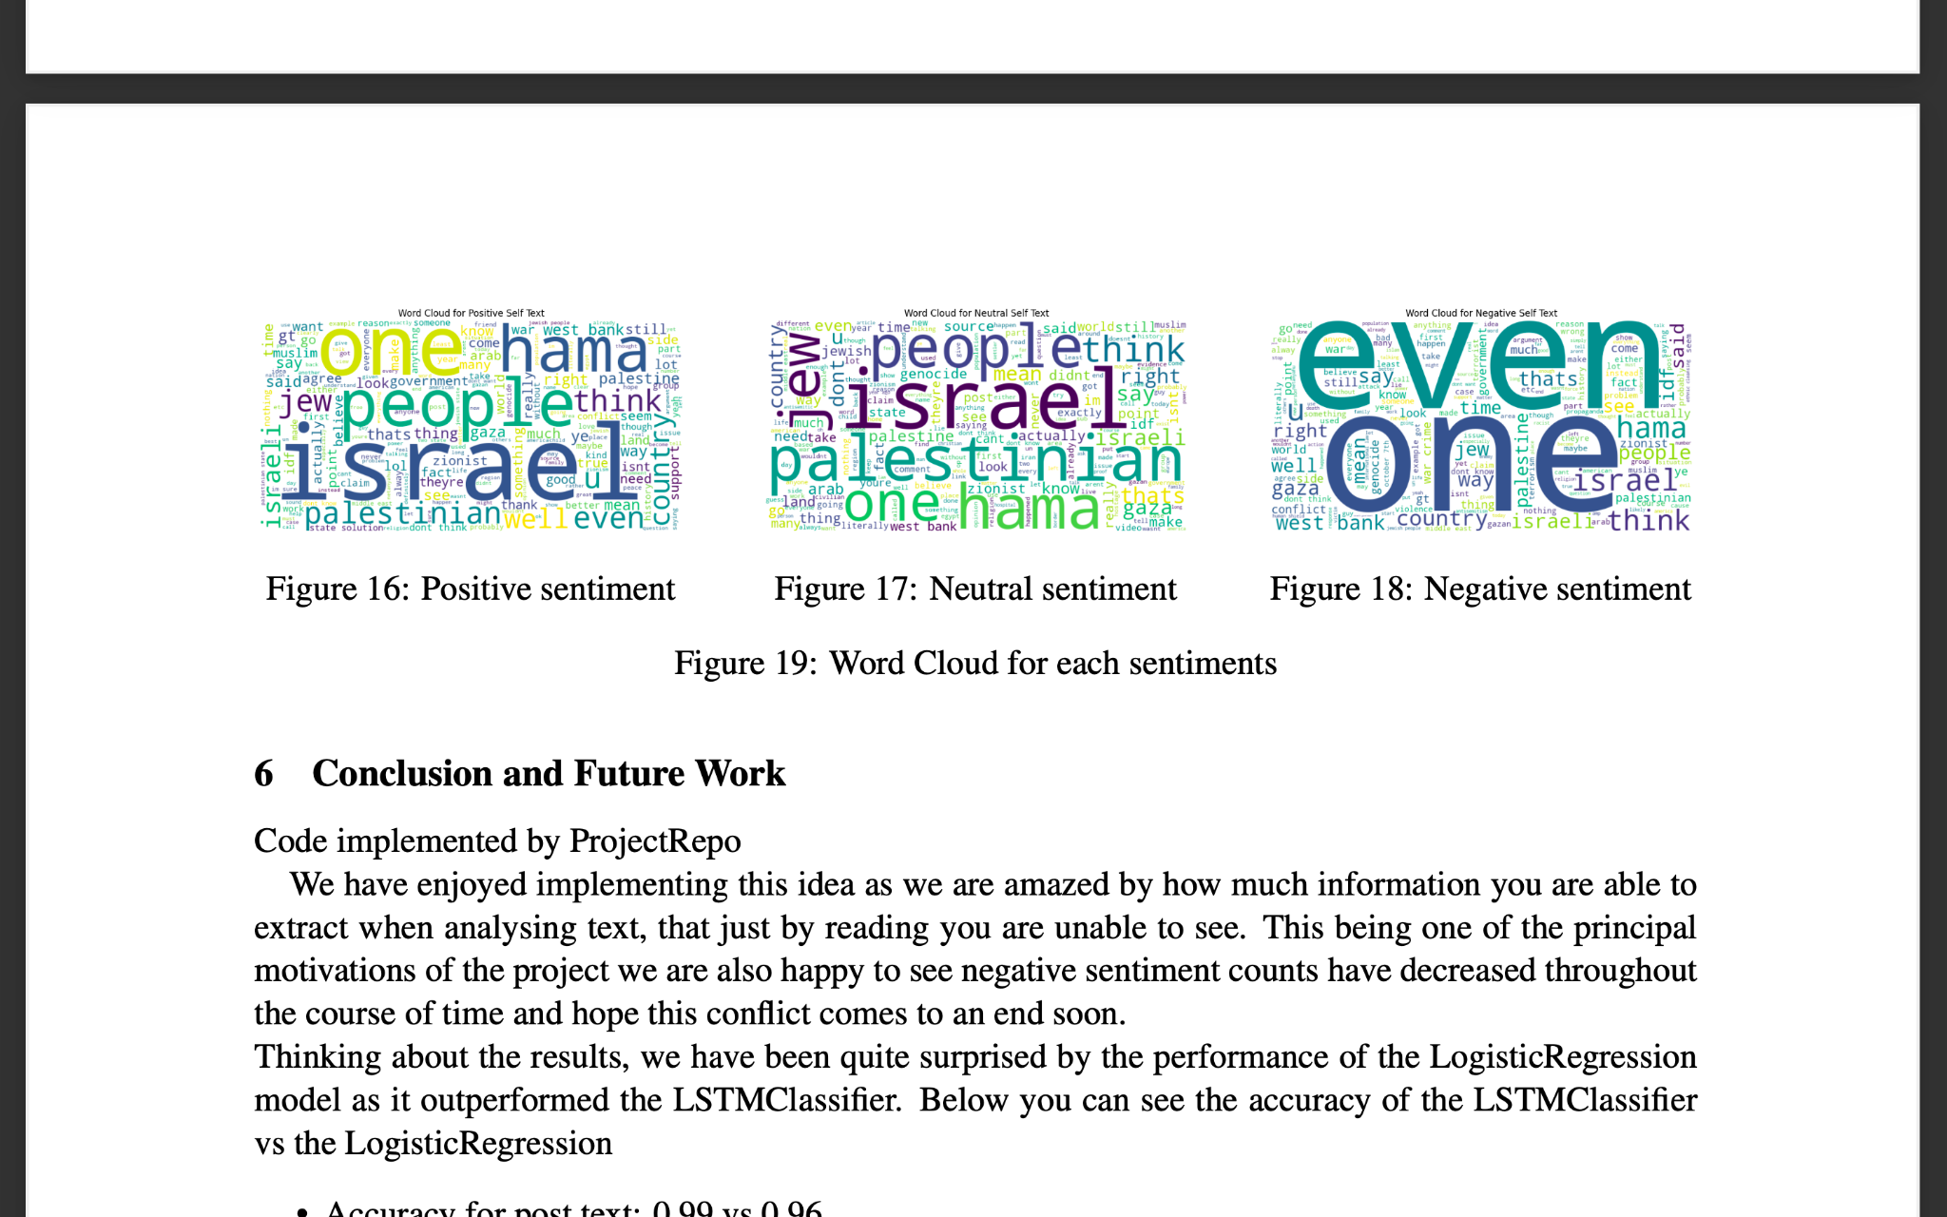
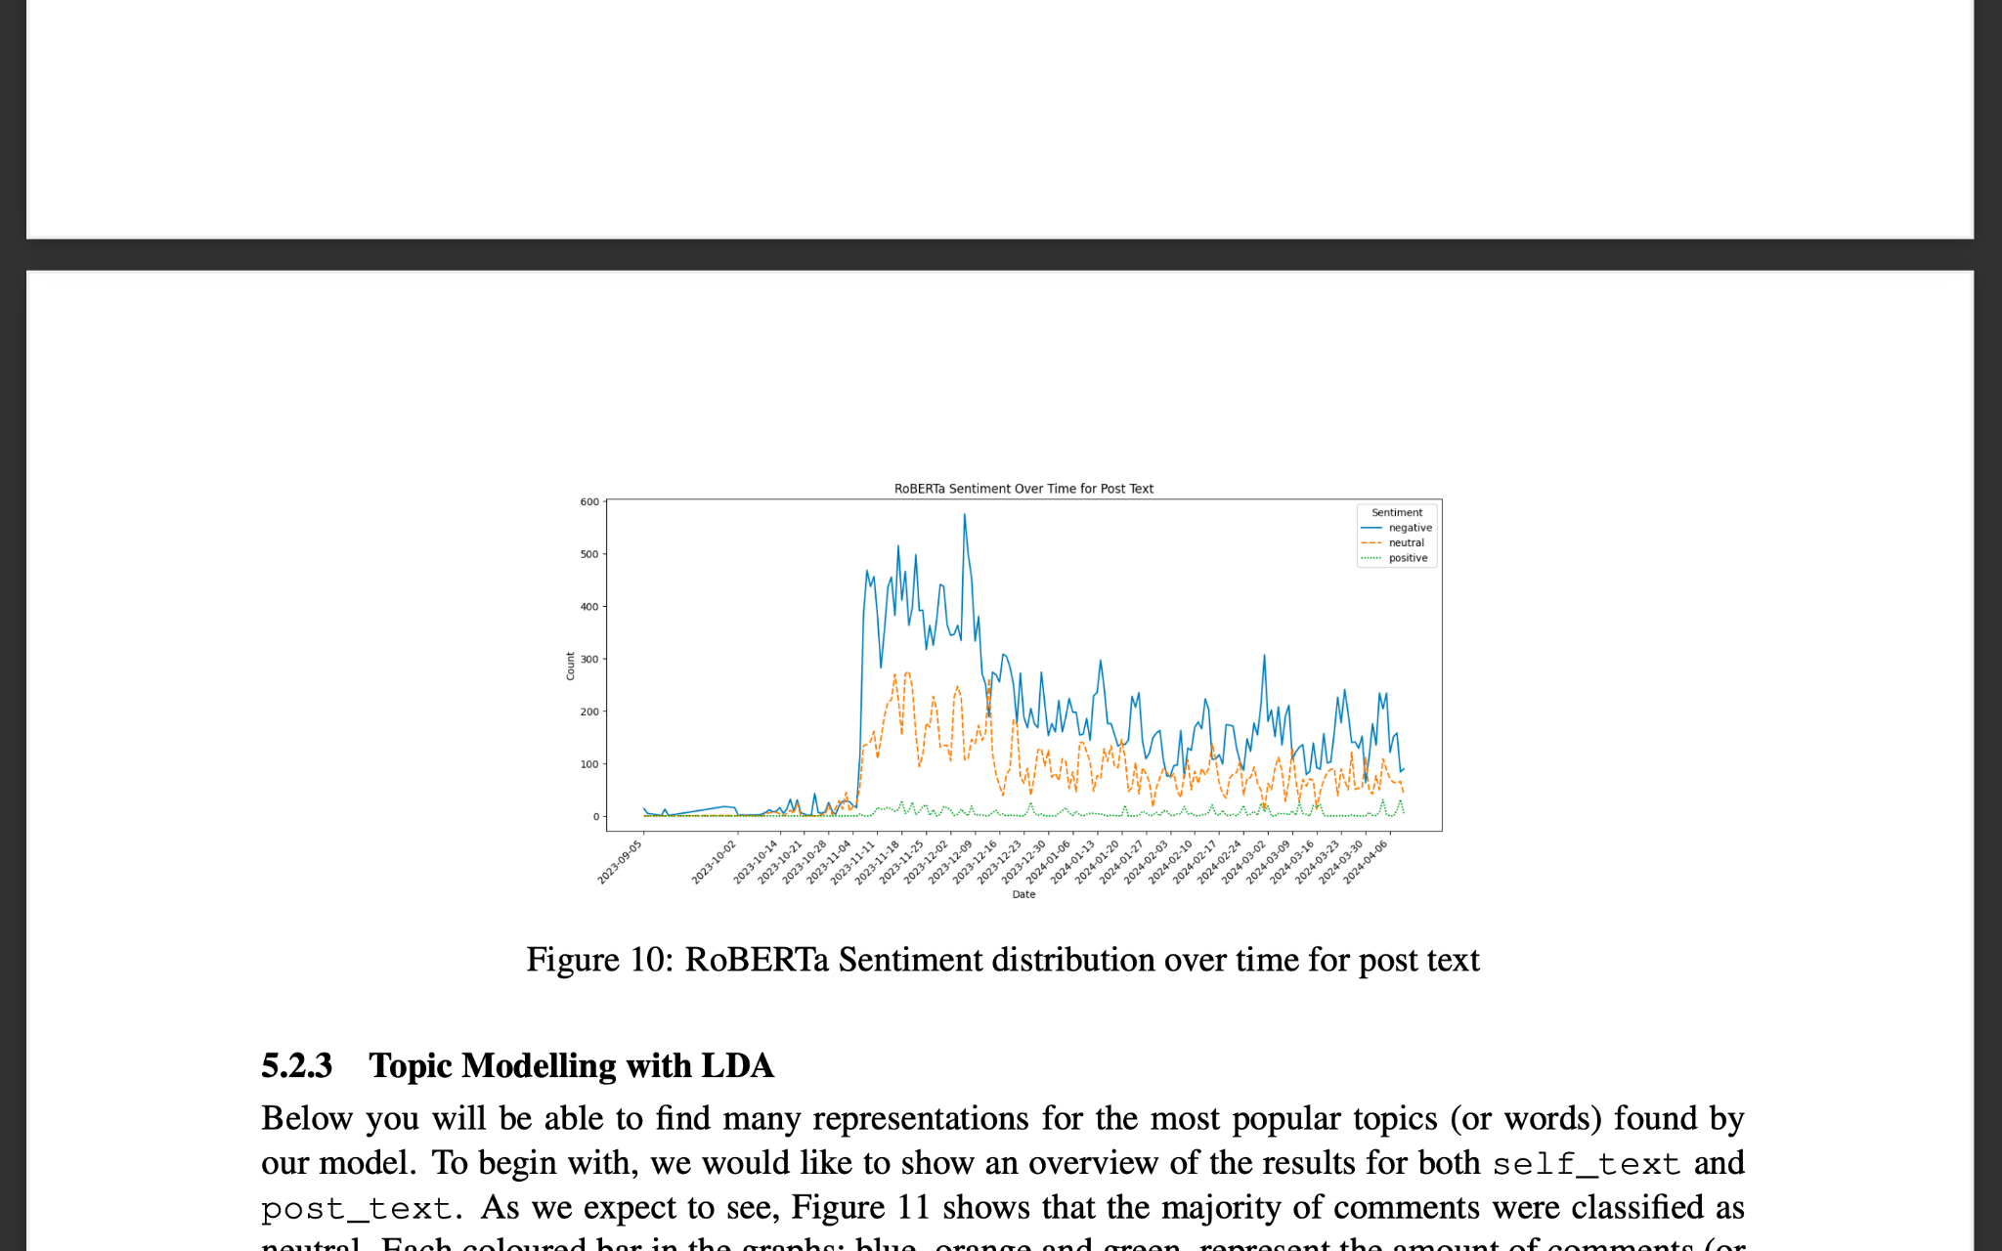
RoBERTa’s Sentiment distribution over time

Slide 13
Future Work
Preprocessing can enhance LSTM performance, especially for comments.
RoBERTa's superior performance suggests adaptability to various text types, including social media.
Fine-tuning RoBERTa can optimize sentiment analysis for diverse text data.
Bidirectional LSTM with RoBERTa's sentiment labels can further improve NLP tasks.

Slide 14


